Slide 1
MARTe2 Users Meeting
EPICSv3 + EPICSv4 = EPICSv7
Andre Neto
May, 2019
Notes:
Use preferably the corporate colours
Use the Calibri or Arial fonts
Don't centre text. All body text should be aligned left.
Don't enlarge pictures beyond their actual size/resolution
Make sure you understand how bulleted lists work.

Slide 2
Objective
Integration with EPICSv3
Monitoring
Commands (i.e. Messages)
Non RT input data source*
Integration with EPICSv7
Structures
Monitoring
Non RT input data source*
Commands (RPC)*
*Available as standard components but not demonstrated in this demo

Slide 3
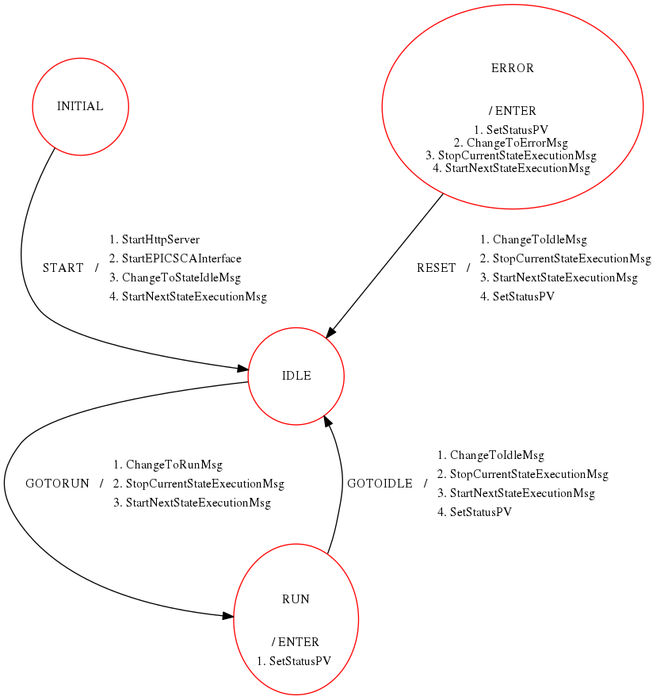
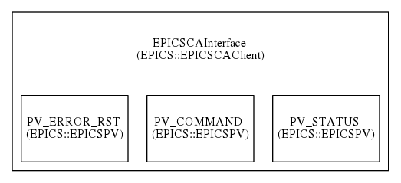
Example 1 – EPICSv3 commands
EPICSCAInterface sends/receives messages to/from StateMachine

Slide 4
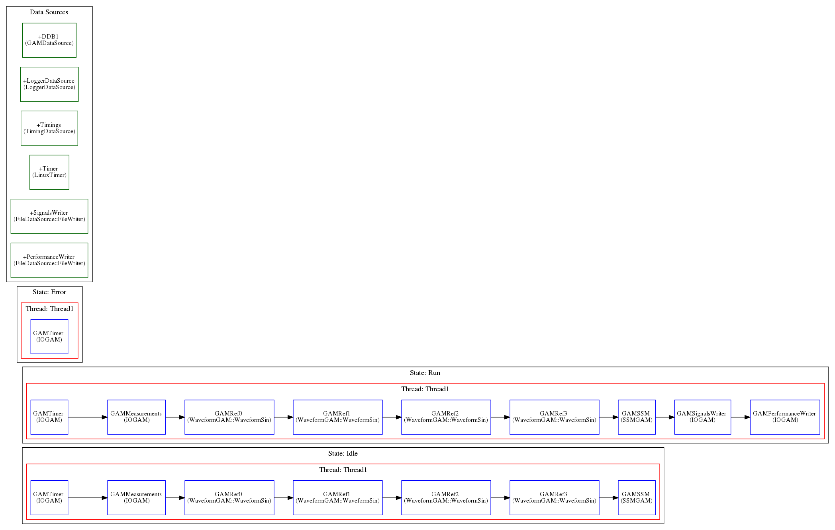
Example 1 – RT Components

Slide 5
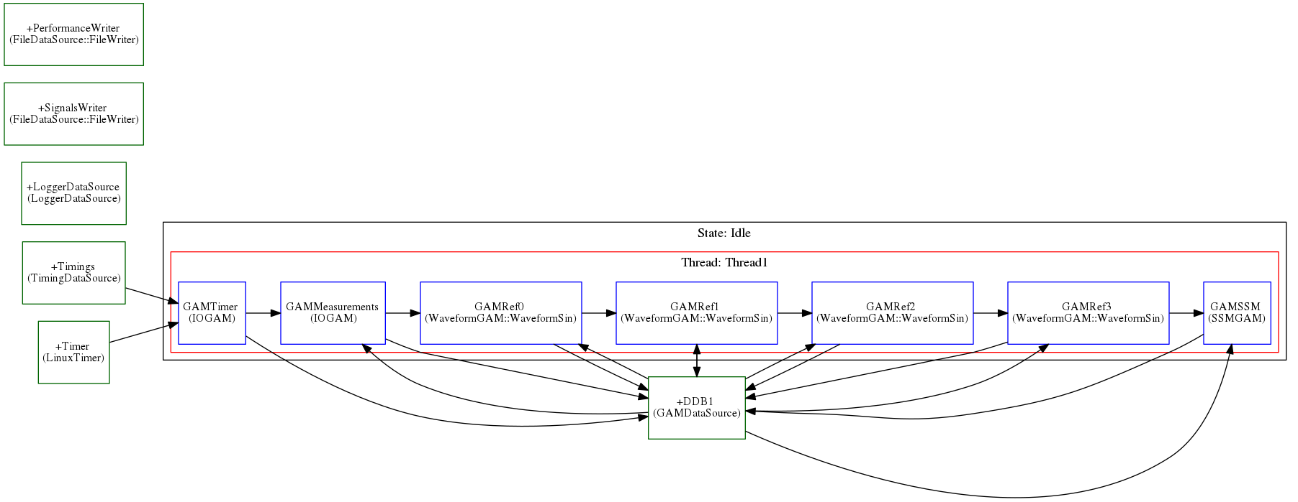
Example 1 – RT Components
Depending on the state, store data in a file

Slide 6
Example1 – How to run
Console #1
cd ~/Projects/MARTe2-demos-padova/Configurations
softIoc -d EPICSv3-demo.db
Console #2
cd ~/Projects/MARTe2-demos-padova/StartUp
./Main.sh -l RealTimeLoader -f ../Configurations/RTApp-EPICSv3-1.cfg -m StateMachine:START
Console #3
caput MARTE2-DEMO-APP:COMMAND 0 && caget MARTE2-DEMO-APP:STATUS && caput MARTE2-DEMO-APP:COMMAND 1 && sleep 2 && caget MARTE2-DEMO-APP:STATUS && sleep 5 && caput MARTE2-DEMO-APP:COMMAND 0
#Open the file /tmp/RTApp-EPICSv3-1.csv and remove the last line
octave
>load('/tmp/RTApp-EPICSv3-1.csv');
>plot(RTApp_EPICSv3_1(:,1), RTApp_EPICSv3_1(:,2), RTApp_EPICSv3_1(:,1), RTApp_EPICSv3_1(:,6))
>legend('Reference0', 'Measurement0')

Slide 7
Example1 – Learn more
View the configuration file
Check what are signals are stored in the file
Plot the error0 and the control0 signals
Some performance figures are also stored in a different CSV
Try to plot them

Slide 8
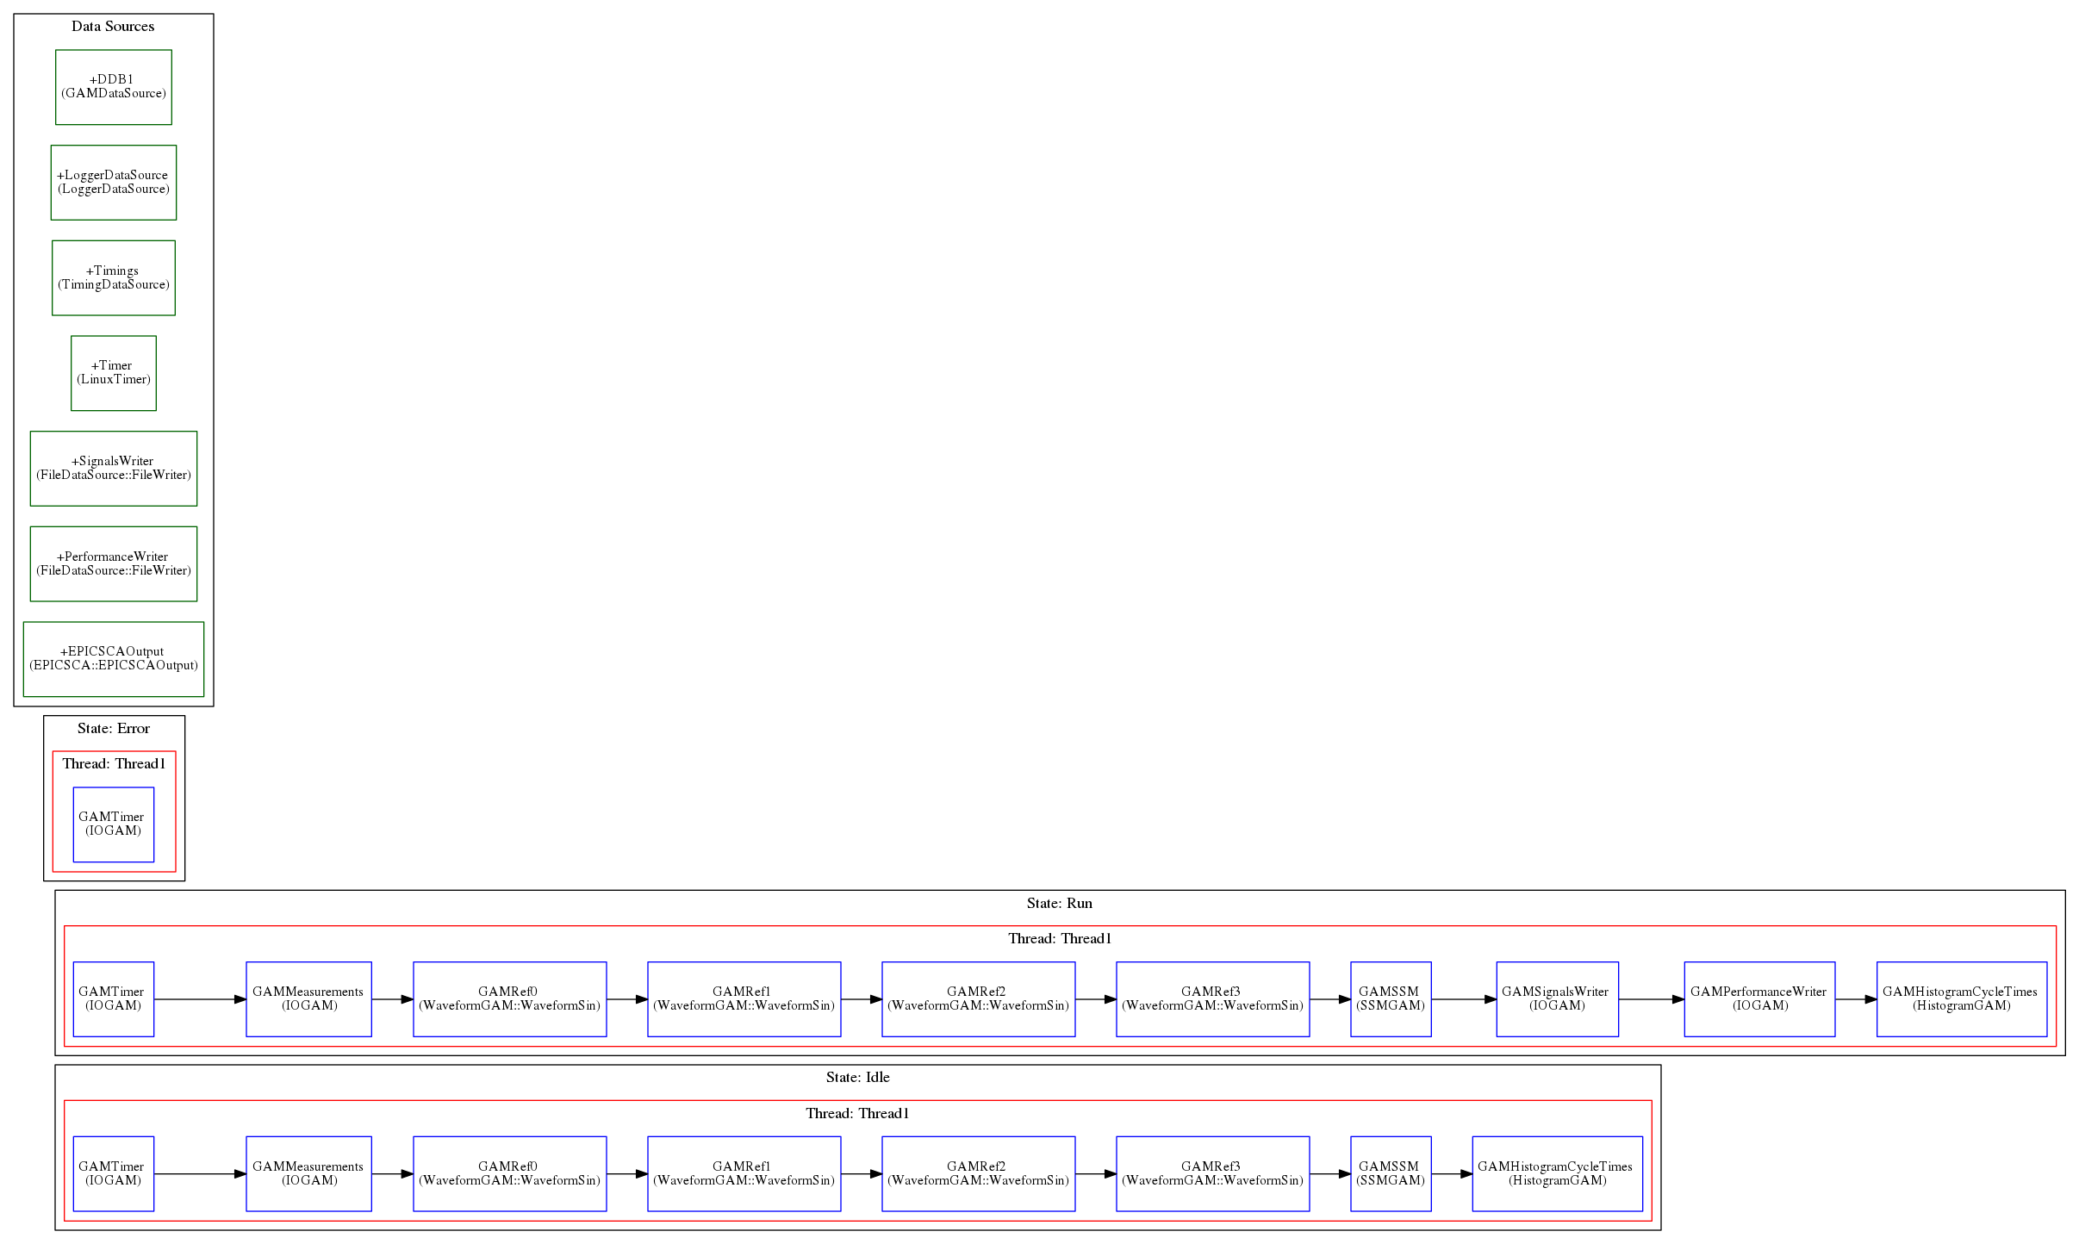
Example 2 – EPICSv3 monitoring
Objectives
Monitor some outputs of the system using EPICSv3

Slide 9
Example 2 – RT Components
Depending on the state, store data in a file
Always monitoring

Slide 10
Example2 – How to run
Console #1
cd ~/Projects/MARTe2-demos-padova/Configurations
softIoc -d EPICSv3-demo.db
Console #2
cd ~/Projects/MARTe2-demos-padova/StartUp
./Main.sh -l RealTimeLoader -f ../Configurations/RTApp-EPICSv3-2.cfg -m StateMachine:START
Console #3
camonitor MARTE2-DEMO-APP:HIST-IDLE-CT

Slide 11
Example2 – Learn more
Export as an EPICS variable also the Measurement0 (MARTE2-DEMO-APP:MEASUREMENT0)
Use an EPICSCAInput and an EPICSCAOutput to connect a control output to a measurement input

Slide 12
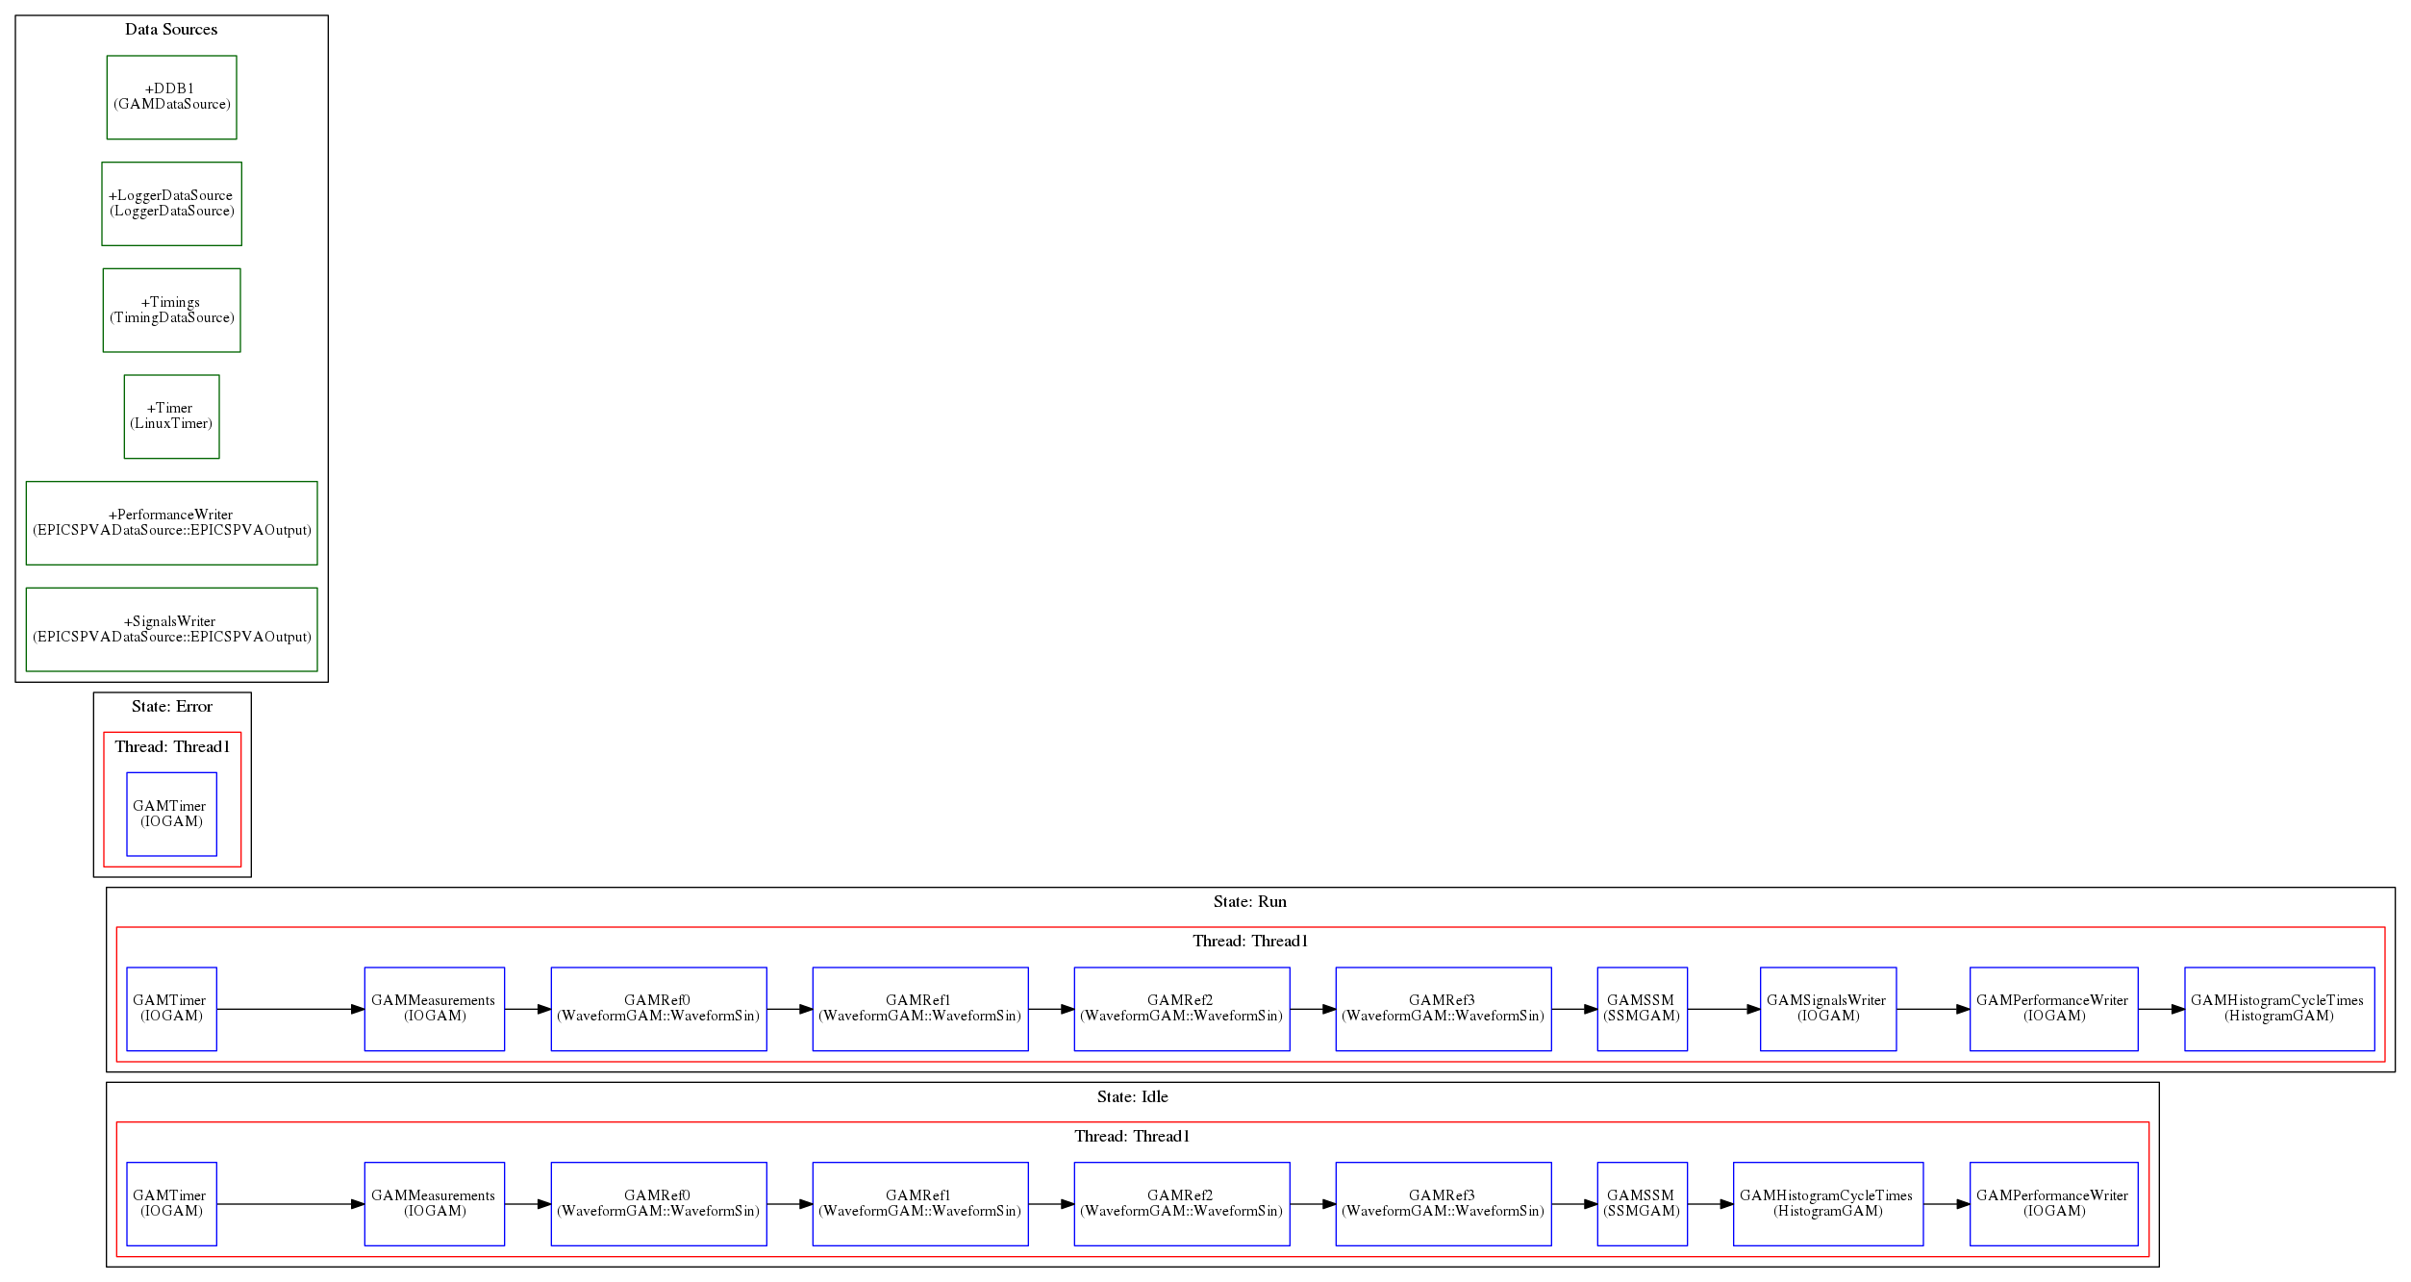
Example 3 – EPICSv7 monitoring
Objectives
Monitor the outputs of the system using EPICSv7
Note how information can be better organized with structured types

Slide 13
Example 3 – RT Components
Note in the configuration file that the types are now structured

Slide 14
Example3 – How to run
Console #1
cd ~/Projects/MARTe2-demos-padova/Configurations
softIoc -d EPICSv3-demo.db
Console #2
cd ~/Projects/MARTe2-demos-padova/StartUp
./Main.sh -l RealTimeLoader -f ../Configurations/RTApp-EPICSv7-1.cfg -m StateMachine:START
Console #3
caput MARTE2-DEMO-APP:COMMAND 1
pvmonitor MARTe2-Demo-App:Statistics
pvmonitor MARTe2-Demo-App:Signals
caput MARTE2-DEMO-APP:COMMAND 0

Slide 15
Example3 – Learn more
Export the State variables in the EPICSv7 structures
Create a configuration file that allows to proxy from/to EPICSv3 to/from EPICSv7
Note the EPICSv3 db file must be update with any new variables that might be required

Slide 16
Thank you for your attention
Follow us on:
www.f4e.europa.eu
www.twitter.com/fusionforenergy
www.youtube.com/fusionforenergy
www.linkedin.com/company/fusion-for-energy www.flickr.com/photos/fusionforenergy

